Slide 1
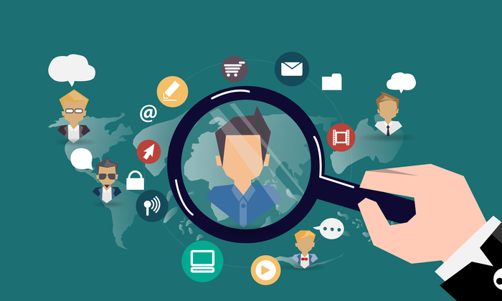
UX
Target Audience
UX
Target Audience
IST 2022

Slide 2
What is a target audience?
The group of humans you expect to use your products. This may be a result of identifying a need amongst a group or generating a need in a group.
But without knowing who will use the item, it is impossible to make it the best it can be.
Notes:
Aged Care:
Target audience:
Employees? Not detailed enough
Residents? Not detailed enough.
Can identify in terms of: Geographic location, Demographic, Psychographic, Behaviour
Geographic locations: Country Australia? Urban area? - Are the employees/residents largely migrants? Are there language issues? Amiable to tech use?
Demographic (dry facts): Are most of the employees/residents' males/females? High/low-income residents? Age range 50-60? 60 -70? 70-80? >80?
Psychographic (motivational issues): What drives the users? Ego? Insecurity? Being valued? Environmental issues?
Behavioural segmentation: Hobbies? Beliefs? Tool usage behaviour - Audio, Text, Video interfaces?, Automated actions? Occasions: Valentine’s day? Fathers/Mothers day?

Slide 3
Who is your target audience?
If you say “millennials” or “German speakers” or “Australians”, then you’re just scratching the surface.
For instance, there are hundreds of different types of Australians — some are vegans, others love meat; some like skydiving, others are happy with just surfing; some own motorbikes, others are scared of them; some have an income of $1 million a year, others live paycheck to paycheck.
The same applies to every target audience that you broadly define. You have to dig deeper.

Slide 4
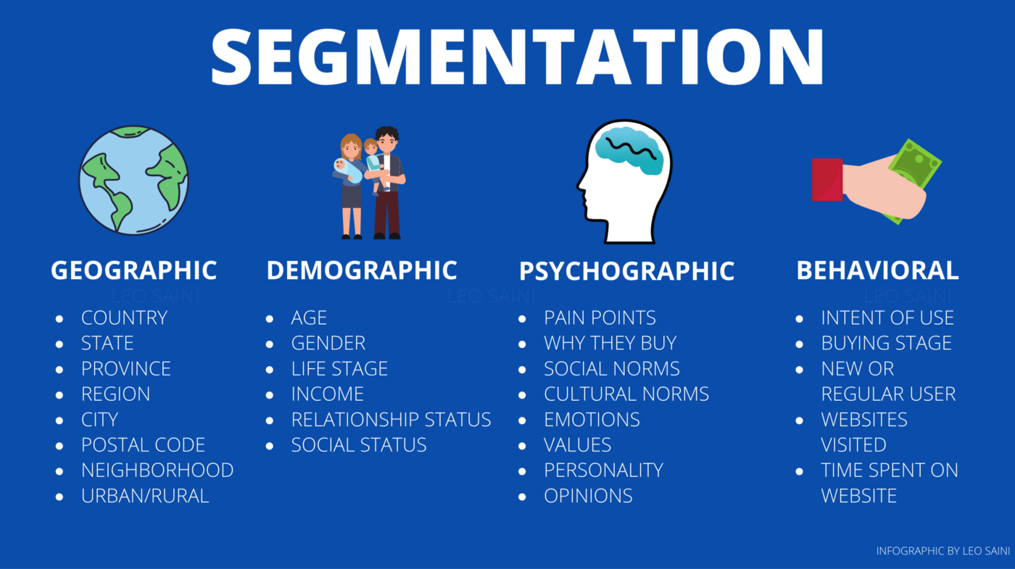
Start with Segmentation

Slide 5
Geographical Segmentation
This segment consists of the geographical region/s you’re targeting. There may be location issues/ language barriers /attitudinal concerns towards your product.
Understanding the region helps with identifying the user.
Based on your location Google ads that appear on your smartphone may change
Based on the climate at your location the products sought will change
McDonald’s menu changes based on the location. E.g. Thailand vs Australia

Slide 6
Demographics
This is where we consider age, gender, race, life stage, social status, income, etc.
If you’re designing a site about parenting, the segment you want to target is, of course, parents.
But you can be more specific using demographic segmentation, for example, your audience could be pregnant mothers in their early 20s with an income of over $4,000 a month.

Slide 7
Example of Demographic Segmentation
Segmenting and marketing based on family circumstances
If you’re a jewellery company, your marketing strategies will vary greatly based on whether the people in your demographic segments are married or unmarried. For example, you’d probably run marketing campaigns and ad-spend around engagement rings at unmarried people, and also those in the 25-35 age range, rather than wasting time and money attempting to market those items to people who’re either married or too young to be.
https://www.qualtrics.com/au/experience-management/brand/demographic-segmentation/

Slide 8
Example of Demographic Segmentation
Segmenting and marketing based on income
Vacation companies that offer a wide range of trips will be keenly aware that demographic segmentation variables make all the difference in terms of converting sales through bespoke marketing. Budget backpacking vacations naturally attract a much different audience to luxury Caribbean all-inclusive packages – but the first step towards targeting each of those target audience types with the right material is running demographic segmentation based on income.
https://www.qualtrics.com/au/experience-management/brand/demographic-segmentation/

Slide 9
Psychographic segmentation
This is where you dig deeper into the psyche of your audience. There’s one thing that I have noticed a lot in marketing — don’t just listen to what your customers say, you also have to listen to what they don’t say.
It’s your job to understand what motivates your customers to buy your product, and you can do that using psychographic segmentation.
For example, some people buy a Lamborghini to boost their egos, but someone may buy it because they’re insecure about their physical appearance and want to compensate for that using an expensive car.

Slide 10
Examples of companies using psychographic segmentation
Patagonia
Recognising the mindset of environmentally conscious outdoor enthusiasts, Patagonia tailored its branding to emphasise sustainability and responsibility.
Their “Don’t Buy This Jacket” campaign challenged consumers to consider the environmental impact of their purchases, advocating for buying less and instead extending the lifespan of each item. Similarly, the brand’s long-lasting Worn Wear initiative encourages customers to trade in their Patagonia gear for repairs. Both speak directly to the eco-conscious values of their target audience.

Slide 11
Examples of companies using psychographic segmentation
Snapchat
Tech company Snapchat really got what young people wanted from a messenger app – pioneering a quick, fun and fleeting form of communication. They took this idea further by introducing ‘Stories’, which only lasted 24 hours, and geofilters to let users show where they are in a fun way.
These features tapped into a younger generation’s love for spontaneous online moments.

Slide 12
Examples of companies using psychographic segmentation
Harley Davidson
Harley Davidson isn’t just selling motorcycles; they’re selling an experience steeped in freedom, adventure and community. The brand understands that their target audience don’t just see bikes as modes of transport, but as symbols of a distinct lifestyle. By hosting events like the Sturgis Motorcycle Rally, Harley nurtures this sense of belonging and camaraderie.
Their success in psychographic segmentation lies in tapping into these deep-rooted emotions and values, ensuring that their marketing and products resonate with the dreams and aspirations of their audience.

Slide 13
Behavioural Segmentation
Users won’t be bothered by your product unless it can benefit them in one of three overarching ways:
Solve a problem.
Address a need.
Do something to make them feel better.
"Get closer than ever to your customers. So close that you tell them what they need well before they realize it themselves.“ - Steve Jobs

Slide 14
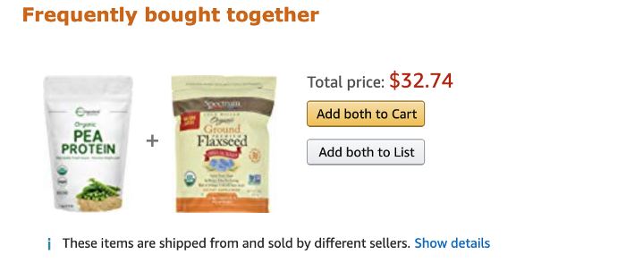
Behavioural segmentation
This is where if you ask 50 people, “do you care about your health?”, almost everyone will give you a resounding “yes”. However, if you look at their behavior, you’ll find a huge difference between what they say and what they do. Given a choice between sugary Coco-Cola and a healthy (but bitter) green juice, a vast majority of the supposedly health-conscious people will choose an unhealthy glass of coke.
Luckily, in this day and age, it’s far easier to track and analyze consumer behavior using tools like Google Analytics, SEMrush, Ubersuggest, etc. For example, Amazon suggests what else you should buy based on your, or previous customers’, buying behavior (as shown in the image).

Slide 15
Sample Target Audience 1
Let’s assume that you’re a writer who’s trying to start a coaching business. Your target audience could look something like this:
Geographic: Lives in the United States, Canada, United Kingdom, New Zealand, Australia.
Demographic: English speakers who are 25 to 45 years old, and have a full-time job with a monthly income of over $6,000.
Psychographic: Desperately want to be a writer because they want to sound like a figure of authority in their field. They’re ambitious, but also enjoy life and don’t mind losing every once in a while.
Behavioral: Spends a lot of time reading books and blogs, listening to podcasts or audiobooks, and watching self-help/business videos on YouTube. They’re also actively looking for online courses to become better at writing.
Hence, the target audience is 25 to 45 years old English speakers in developed English-speaking countries, who want to be writers to establish themselves as authority figures.

Slide 16
Know your audience
Look at statistics
Interviews
Research
Create a persona
Know the law

Slide 17
Stats
The Australian Government uses Aged Care Planning Regions (ACPRs) to plan the distribution and types of aged care services to be made available across Australia.
On 30 June 2021, approximately 371,000 people were using residential aged care, home care or transition care in Australia. This comprises 191,000 people using permanent or respite residential aged care, 176,000 using home care and 3,700 using transition care. In addition, during 2020–21 over 825,000 people were assisted under the Commonwealth Home Support Programme (home support).
30 June 2021
What can stats tell you about your project/audience

Slide 18
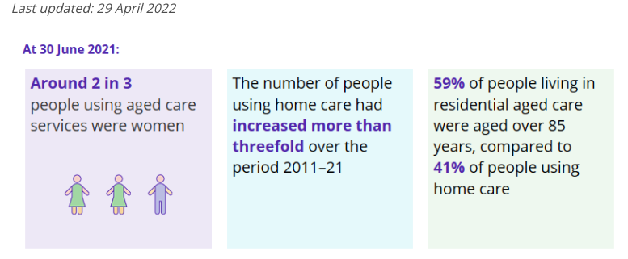
Stats Australia

Slide 19
Stats
Look at as many stats as you can to inform your decisions… This will help you formulate what your target audience looks like.
Eg: if 20% of people in NSW want animals but don’t all have the space, or time, would they be a realistic target for a large dog?
If covid resulted in a lot of homes already taking animals, is there still room for more adoption?
Remember mortality of animals is also a factor.

Slide 20
Where can you get Statistics
Australian Bureau of Statistics
https://www.olg.nsw.gov.au/public/dogs-cats/responsible-pet-ownership/pound-and-dog-attack-statistics/
https://www.rspca.org.au/what-we-do/our-role-caring-animals/annual-statistics
Google Analytics (from sites related to this)

Slide 21
Talk to People - Interviews
Why ask people?
Shifting Attitudes
Different views to your own
Empathy

Slide 22
Research
Aged care in Eastern Suburbs: link
Aged care admission fact sheet: link
People using aged care: link

Slide 23
Example of questions you would ask in an Interview of residents to discover needs
How has your experience been with the aged care technology that is available to you in this facility?
What do you find to be the most helpful feature of the technology that you currently use, and why?
Can you describe any difficulties or frustrations you have experienced while using the technology in the aged care facility?
How often do you use the technology provided to you, and for what specific tasks?
Is there any additional technology or features that you would like to see incorporated into the aged care technology available to you?

Slide 24
Qualitative question examples - please customise to your product
Is the sign-up/sign-in process easy to find on the wireframe? (Provide clear and neat images)
Are the form fields clearly labeled and easy to understand?
Is the form layout visually appealing and user-friendly?
Is the sign-up/sign-in process straightforward and intuitive?
Are there any unnecessary form fields or steps in the process?
Are there any error messages or alerts for incomplete or incorrect input?
Is there an option for users to recover their account if they forget their login credentials?
Is there an option for users to stay logged in, or for the system to remember their login details?
Is there any additional information provided to help users understand why they need to sign up/sign in?
Is there a clear call to action, such as a button or link, to initiate the sign-up/sign-in process?

